Slide 1

General & Presidential Voter Turnout
Brynn Hamilton

Slide 2
Objective
Train the machine learning models to accurately predict voter turnout per general election year and presidential election year, by State and the entire United States, based on the eligible voting population and history of previous voter turnout per election.
Construct model from data for 1789-2018 voter turnout for each election (every 2 years) for the entire United States.
Construct model from data for 1980-2014 voter turnout for each election (every 2 years) for each State.

Slide 3
Key Points
Training the models
Type of algorithm
Tuning the models accuracy
Building the API
Scripting data into SQLite database
Creating end points
Building Visualizations
Scatterplots of actual vs predictive models (Plotly)
US heatmap of voter turnout per State per year (D3)

Slide 4
Training the models – Type of Algorithm
Test fit with linear regression
Plot proved linear regression model inaccuracy
First data-set had multiple features: year, general vs presidential, State, voter populations (eligible, of age)
Second data-set had more data, but only year, general vs presidential, and total U.S. voter turnout
Refined the model with a non-linear regression
Non-linear - Used Support Vector Regression (SVR) to train model with RBF kernel (Radial Basis Function) which worked well with minimal data, minimal features
Ran RBF & polynomial to test fit again. RBF & linear worked, polynomial ran for 9+ hours and was unsuccessful. RBF fit well. Proceeded with RBF algorithm

Slide 5
Training the models – Fine tuning the fit
Trained the model with SVR - RBF ( Support Vector Regression & Radial Basis Function)
Plotted out the predicted regression line vs the actual
Fine tuning & Verification
Tested multiple parameters from Scikit learn SVR documentation
Regularization parameter – increased to 800 to iterate and fit line more accurately & accounted for outliers
At 100 - MSE = 0.63; RMSE = 0.79
At 800 – MSE = 0.01; RMSE = 0.1)
Coefficient of Determination
At 100 = 0.99
At 800 = 0.9999

Slide 6
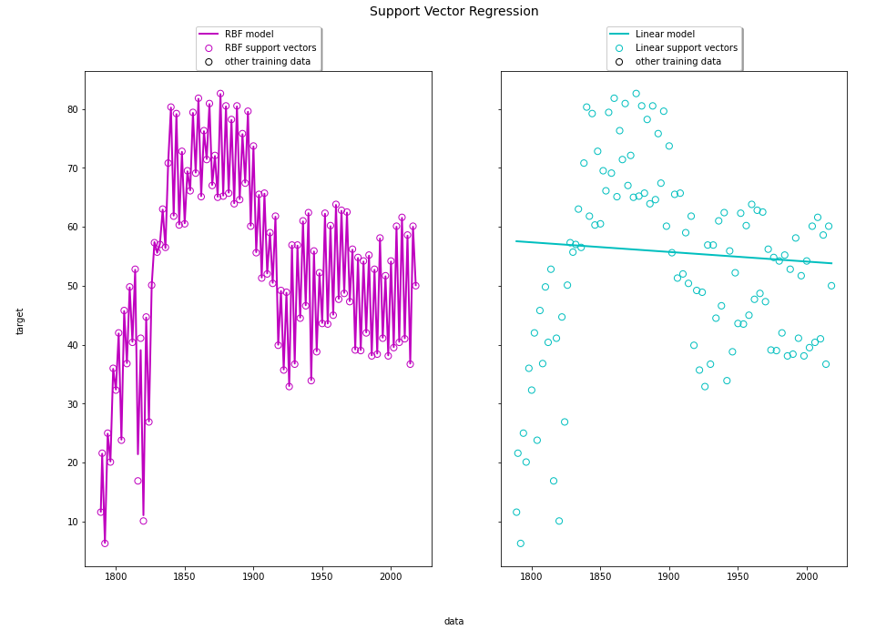

Slide 7
Building the API - Database
Put existing data (CSVs) into SQLite database
No data cleaning required, imported columns of reference
Created tables to host historic data and train model for API (actual & predictive)
US voter turnout table- year, presidential or general, voter turnout rate
State vote turnout table- year, state (state name & numeric code due -to scikit functioning on numeric not string-, voting eligible population, voting of age population, voter turnout percent)
State codes table – state name, state code, states abbreviation

Slide 8
Building the API - Endpoints
/us-voter-turnout/historic | Entire United States & all years for actual reported voter turnout
/us-voter-turnout/predict/all | Predictive model for entire United States for all years (1789-2018)
/us-voter-turnout/predict/[year] | Predictive model for entire United States for specific/each year
/state-voter-turnout/historic | Each State across all years for actual reported voter turnout (1980-2014)
/state-voter-turnout/predict/all | Predictive model for all/each State(s)
/state-voter-turnout/predict/[year]/[state] | Predictive model for a specific State and a specific year

Slide 9
Limitations
Small datasets
Per State dataset has only 18 records to train the model (1980-2014, per 2 years).
Entire United States dataset has approximately 115 records
Parameters
History of voter turnout
Eligible voting population
Type of election (General or Presidential)

Slide 10
Areas of Interest
More data or other data sources
Trending on Social Media (Twitter, Facebook)
Public records
Parameters
Population demographics (age, race, gender)
Political party affiliation
Availability and convenience of polling locations
Election candidates
Renewing term or first-time campaign
Current political administration’s approval rating

